Slide 1
6th Grade Practice EOG Review
March 2019

Slide 2
Question 1: What is the product of 15.4 and 2.6?

Slide 3
Question 2: Four people evenly share ¼ of a pizza. What fraction of the whole pizza with each person eat?

Slide 4
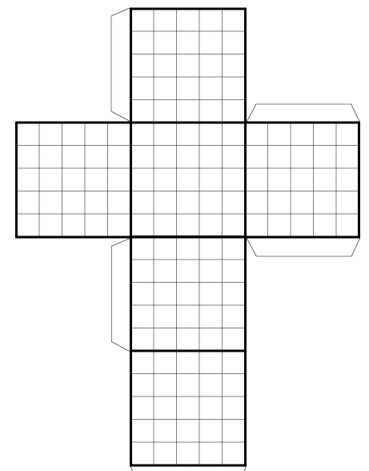
Question 3: Susan made a case for her iPad using the net shown. What is the total surface area of her iPad case?

Slide 5
Question 4: 4$\frac{1}{2} ÷ \frac{2}{3}$

Slide 6
Question 5: The 400 members of the homeowners association voted for the new president. The person with the largest number of votes became the new president. Based on the chart, How many members voted for the winner?
Name of Candidate | Percent of Votes
Lisa | 40%
Larry | 25%
George | 35%

Slide 7
Question 6: Jerry reconditions TVs and sells them for half of what they cost new. Write an equation to represent the cost of r (reconditioned TV cost) and N (cost of new tv).

Slide 8
Question 7: What is the total area for this figure? (All measurements are in inches)

Slide 9
Question 8: Find the volume of this prism. Each cube has the edge lengths of ½ inches

Slide 10
Question 9: 5 + $b^{2}$ ∙ c ÷ 2 b= 5 and c= 12

Slide 11
Question 10: Janis is surveying her class for a report. She asks her classmates about their height in inches. How many students surveyed have a height greater than 70 inches?
Height in Inches:
75 | 80 | 65
40 | 45 | 70
72 | 80 | 81
84 | 76 | 55
65 | 66 | 72

Slide 12
Question 11: Victor added three multi-digit numbers. The first number is 10.6 The second number was 10 times the first number. The third number was 10 times the second number. What was the sum?

Slide 13
Question 12: How does the median compare to the interquartile range of the data?

Slide 14
Question 13: Lola has $50 in her savings account. She will add $5 each week and does not take any money out of the account. Write an expression to represent the amount in her savings account after X weeks.

Slide 15
Question 14: 6,036 ÷ 12

Slide 16
Question 15: Solve the following using distributive property 5 ( 5 + 9 )

Slide 17
Question 16: If it takes 22 cookies to fill a tin, how many tins can a baker fill will 150 cookies?

Slide 18
Question 17: Kelly’s teacher asked her to place the fraction $\frac{28}{3}$ on the number line. Between what two number will $\frac{28}{3}$ fall?

Slide 19
Answer Key: 1. 40.04 2. $\frac{1}{16}$ 3. ${150 units}^{2}$ 4. $6\frac{3}{4}$ 5. 160 Members 6. r = n ÷ 2 7. ${119 in}^{2}$ 8. ${27 units}^{3}$ 9. 155 10. 8 students 11. 1176.6 12. Median=7 IQR=3 13. y=5x + 50 14. 503 15. 25 + 45 = 70 16. 6 tins, remainder 18 cookies 17. A=9 B=10

