Slide 1
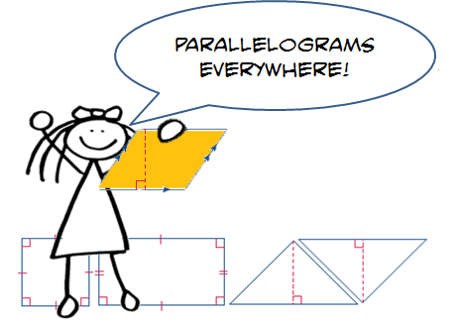
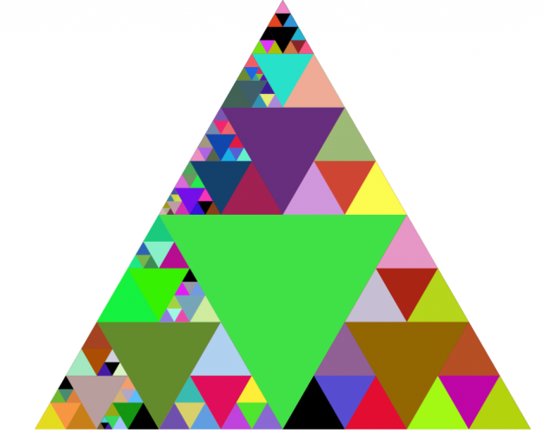
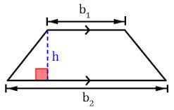
Unit 5: Area and Volume Part I: Area
Area of Parallelograms
Area of Triangles
Area of Trapezoids
Changes in Dimensions
Area of Composite Figures

Slide 2
Georgia Standards
MCC6.G.1.Find the area of right triangles, other triangles, special quadrilaterals, and polygons by composing into rectangles or decomposing into triangles and other shapes; apply these
techniques in the context of solving real world and mathematical problems.
MCC6.G.2.Find the volume of a right rectangular prism with fractional edge lengths by packing it with unit cubes of the appropriate unit fraction edge lengths, and show that the volume
is the same as would be found by multiplying the edge lengths of the prism. Apply the formulas V = l w h and V = b h to find volumes of right rectangular prisms with fractional edge lengths in the context of solving real -world and mathematical problems.
MCC6.G.4.Represent three - dimensional figures using nets made up of rectangles and triangles, and use the nets to find the surface area of these figures.

Slide 3
Mathematical Practices
Make sense of problems and persevere in solving them.
Reason abstractly and quantitatively.
Construct viable arguments and critique the reasoning of others.
Model with mathematics
Use appropriate tools strategically.
Attend to precision.
Look for and make use of structure.
Look for and express regularity in repeated reasoning

Slide 4
Essential Questions
How does measurement help you solve problems in everyday life?
How do you find the areas and missing dimensions of parallelograms?
How are parallelograms related to triangles and rectangles?

Slide 5
Vocabulary
Area: is the number of square units needed to cover the surface of the figure.
Base: a side or bottom.
Composite Figure: is a figure made of two or more two-dimensional figures.
Congruent: figures that are the same shape and size.
Formula: an equation that shows the relationship among certain quantities.
Height: is the perpendicular distance from the base to the opposite side.
Parallelogram: is a quadrilateral with opposite sides parallel and opposite sides the same length.
Polygon: is a closed figure formed by 3 or more straight lines.
Rhombus: is a parallelogram with four equal sides.

Slide 6
Area Formulas
Remember:
Determine the Shape
Write the Formula
Plug Into the Formula Info Given
Perform Order of Operations and Show Work
5. Solution Check
6. Check Solution
Does It Make Sense?
Parallelogram A = bh
Triangle A = 1/2bh or
A = bh 2
Trapezoid A = 1/2h(b1 + b2) or
A = h(b1 + b2)
2

Slide 7
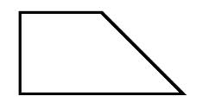
Area Foldable
Area of a Rectangle A = lw | A = bh Area of a Parallelogram
Area of a Triangle A = ½ bh | A = ½ (b1 + b2)h Area of a Trapezoid

Slide 8
Area Foldable
Area of a Rectangle A = lw A = (9cm)(3cm) A= 27 cm² | A = lw 9 cm 3 cm | A = bh 6 in 4 in | Area of a Parallelogram A = bh A = (4in)(6in) A= 24 in²
Area of a Triangle A= ½ bh A= ½(6m)(7m) A = ½ (42m²) A = 21 m² | A = ½ bh 7m 6m | A = ½ (b1 + b2)h 2cm 3cm 6cm | Area of a Trapezoid A = ½ (b1 + b2)h A = ½(2cm + 4cm)3cm A = ½ (6cm)3cm A = ½ (18cm²) A = 9cm²

Slide 9
Lesson 1: Area of Parallelograms
Example 1: Find the area of the parallelogram.
The base is 6 units, and the height is 8 units.
A = bh Area of parallelogram
A = 6 x 8 Replace b with 6 and h with 8
A = 48 Multiply
The area is 48 square units or 48 units².
An Area measurement can be written using abbreviations and an exponent of 2.

Slide 10
Lesson 1: Area of Parallelograms
Example 2: Find the area of the parallelogram.
The base is 6 units, and the height is 8 units.
A = bh Area of parallelogram
A = 20 x 11 Replace b with 20 and h with 11
A = 220 Multiply
The area is 220 square centimeters or 220 units².
11 cm
20 cm

Slide 11
Lesson 1: Area of Parallelograms
Got It? Do these problems to find out.
a. b.
16m
4m

Slide 12
Lesson 1: Area of Parallelograms
Example 3: Find the missing dimensions of the parallelogram.
a. 9 in
A = 45 in²
A = bh Area of parallelogram
45 = 9 x h Replace A with 45 and b with 9
45 = 9 h Divide each side by 9
9 9
= h Simplify
So, the height is 5 inches.

Slide 13
Lesson 1: Area of Parallelograms
Got It? Do these problems to find out.
c. d.
6m
A = 96 yd²
8 yd
A = 48 m²

Slide 14
Lesson 1: Area of Parallelograms
Example 4: Jada is painting a replica of the national flag of Trinidad and Tobago for a research project. Find the area of the black stripe.
The black stripe is shaped
like a parallelogram. So, use
the formula A = bh.
A = bh
A = 6 ¾ x 12
A = 81
The area of the flag that is black is 81 square inches.
12 in
6 ¾ in

Slide 15
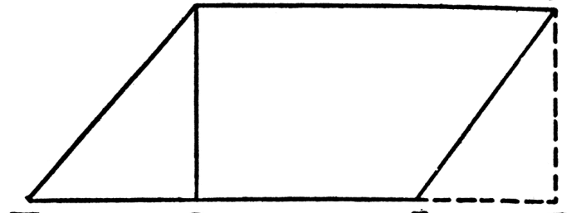
Lesson 1: Area of Parallelograms
Guided Practice
Find the area of each parallelogram.
1. 2.
3.
10 ft
5 ft
8 m
7 m
11 m

Slide 16
Lesson 1: Area of Parallelograms
Guided Practice: Find the area of each parallelogram.
Find the height of a parallelogram if its base is 35 centimeters and its area is 700 square centimeters.
The size of the parallelogram piece in a set of tangrams is shown below. Find the area of the piece.
6 cm
5.1 cm
2.6 cm

Slide 17
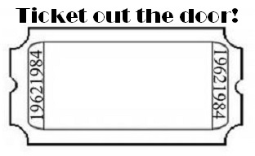
Lesson 1: Area of Parallelograms
How are parallelograms related to triangles and rectangles?

