Slide 1
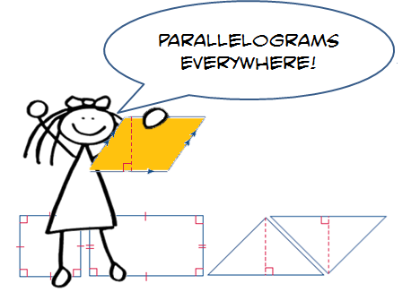
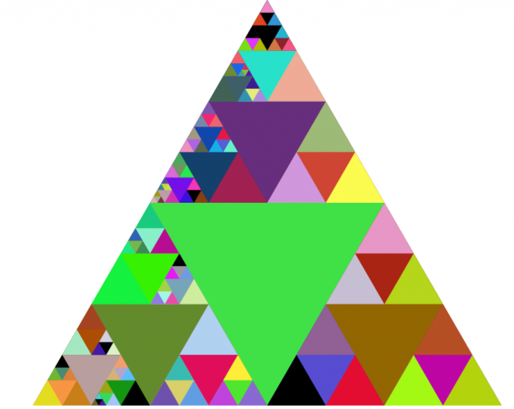
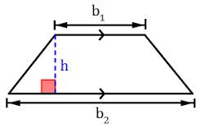
Unit 5: Area and Volume Part I: Area
Area of Parallelograms
Area of Triangles
Area of Trapezoids
Changes in Dimensions
Area of Composite Figures

Slide 2
Georgia Standards
MCC6.G.1.Find the area of right triangles, other triangles, special quadrilaterals, and polygons by composing into rectangles or decomposing into triangles and other shapes; apply these
techniques in the context of solving real world and mathematical problems.
MCC6.G.2.Find the volume of a right rectangular prism with fractional edge lengths by packing it with unit cubes of the appropriate unit fraction edge lengths, and show that the volume
is the same as would be found by multiplying the edge lengths of the prism. Apply the formulas V = l w h and V = b h to find volumes of right rectangular prisms with fractional edge lengths in the context of solving real -world and mathematical problems.
MCC6.G.4.Represent three - dimensional figures using nets made up of rectangles and triangles, and use the nets to find the surface area of these figures.

Slide 3
Mathematical Practices
Make sense of problems and persevere in solving them.
Reason abstractly and quantitatively.
Construct viable arguments and critique the reasoning of others.
Model with mathematics
Use appropriate tools strategically.
Attend to precision.
Look for and make use of structure.
Look for and express regularity in repeated reasoning

Slide 4
Essential Questions
How does measurement help you solve problems in everyday life?
How do you find the areas and missing dimensions of parallelograms?
How are parallelograms related to triangles and rectangles?

Slide 5
Vocabulary
Area: is the number of square units needed to cover the surface of the figure.
Base: a side or bottom.
Composite Figure: is a figure made of two or more two-dimensional figures.
Congruent: figures that are the same shape and size.
Formula: an equation that shows the relationship among certain quantities.
Height: is the perpendicular distance from the base to the opposite side.
Parallelogram: is a quadrilateral with opposite sides parallel and opposite sides the same length.
Polygon: is a closed figure formed by 3 or more straight lines.
Rhombus: is a parallelogram with four equal sides.

Slide 6
Homework Week

Slide 7
Homework Week

Slide 8
Homework Week

Slide 9
Homework Week

Slide 10
Homework Week

Slide 11
Homework Week

Slide 12
Homework Week

Slide 13
Homework Week

Slide 14
Homework Week

Slide 15
Homework Week

Slide 16
Homework Week

Slide 17
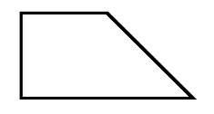
Area Foldable
Area of a Rectangle A = lw | A = bh Area of a Parallelogram
Area of a Triangle A = ½ bh | A = ½ (b1 + b2)h Area of a Trapezoid

Slide 18
Area Foldable
Area of a Rectangle A = lw A = (9cm)(3cm) A= 27 cm² | A = lw 9 cm 3 cm | A = bh 6 in 4 in | Area of a Parallelogram A = bh A = (4in)(6in) A= 24 in²
Area of a Triangle A= ½ bh A= ½(6m)(7m) A = ½ (42m²) A = 21 m² | A = ½ bh 7m 6m | A = ½ (b1 + b2)h 2cm 3cm 6cm | Area of a Trapezoid A = ½ (b1 + b2)h A = ½(2cm + 4cm)3cm A = ½ (6cm)3cm A = ½ (18cm²) A = 9cm²

Slide 19
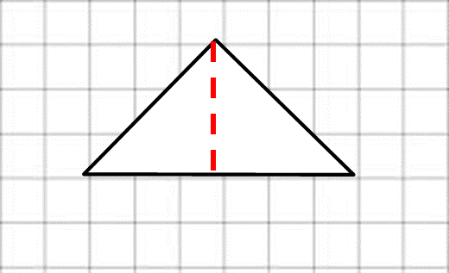
Lesson 2: Area of Triangles
Example 1: Find the area of the Triangle.
The base is 6 units, and the height is 4 units.
A = 1/2bh Area of triangle
A = ½(6 x 4) Replace b with 6 and h with 4
A = ½(24) Multiply
A = 12 Divide
The area is 12 square units or 12 units².
height
base
a.

Slide 20
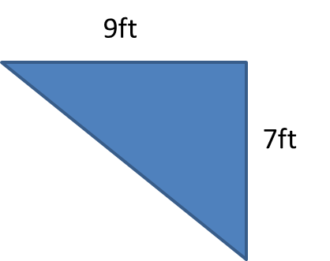
Lesson 2: Area of Triangles
Example 2: Find the area of the triangle.
12.1m
A = 1/2bh Area of triangle
A = ½(12.1)(6.4) Replace b with 12.1 and h with 6.4
A = ½(77.44) Multiply
A = 38.72 Divide
The area is 38.72 square meters or 38.72 m².
6.4 m
b.

Slide 21
Lesson 2: Area of Triangles
Example 3: Find the missing dimensions of the triangle.
6cm
A = 24 cm²
A = 1/2bh Area of triangle
24 = ½( b x 6) Replace A with 24 and h with 6
(2)24 = (b x 6) (2) Multiply each side by 2
2
= b x 6 Divide each side by 6
6
8 = b Simplify
So, the base is 8 centimeters.

Slide 22
Lesson 2: Area of Triangles
Got It? Do these problems to find out.
c. d.
A = 40 m²
h
8m
A = 72 yd²
12 yd
b

Slide 23
Lesson 2: Area of Triangles
Example 4: the front of a camping tent has the dimensions shown. How much material was used to make the front of the tent?
A = 1/2bh
A = ½ (5)(3)
A = ½(15) or
A = 7.5
The front of the tent has an area of 7.5 square feet.
3 ft
5 ft

Slide 24
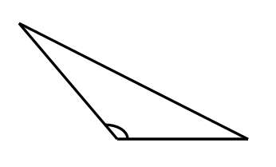
Lesson 2: Area of Triangles
Guided Practice
Find the area of each triangle.
1. 2.
3.
8ft
12 ft
11.25m
15.6m

Slide 25
Lesson 2: Area of Triangles
Guided Practice: Find the area of each Triangle.
Tashawn designs uniquely shaped ceramic floor tiles. What is the base of the tile shown?
b
6in
A = 21 in²
Emily made a triangular paper box as shown. What is the area of the top of the box?
9 cm
10cm

Slide 26
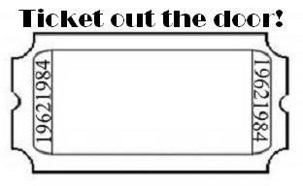
Lesson 2: Area of Triangles
How is the formula for the area of a triangle related to the formula for the area of a parallelogram?

