Slide 1
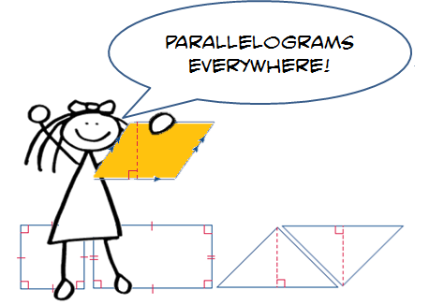
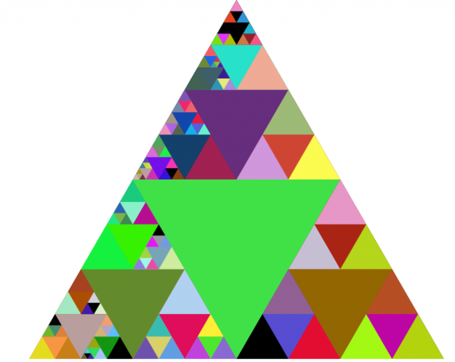
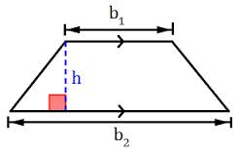
Unit 5: Area and Volume Part I: Area
Area of Parallelograms
Area of Triangles
Area of Trapezoids
Changes in Dimensions
Area of Composite Figures

Slide 2
Georgia Standards
MCC6.G.1.Find the area of right triangles, other triangles, special quadrilaterals, and polygons by composing into rectangles or decomposing into triangles and other shapes; apply these
techniques in the context of solving real world and mathematical problems.
MCC6.G.2.Find the volume of a right rectangular prism with fractional edge lengths by packing it with unit cubes of the appropriate unit fraction edge lengths, and show that the volume
is the same as would be found by multiplying the edge lengths of the prism. Apply the formulas V = l w h and V = b h to find volumes of right rectangular prisms with fractional edge lengths in the context of solving real -world and mathematical problems.
MCC6.G.4.Represent three - dimensional figures using nets made up of rectangles and triangles, and use the nets to find the surface area of these figures.

Slide 3
Mathematical Practices
Make sense of problems and persevere in solving them.
Reason abstractly and quantitatively.
Construct viable arguments and critique the reasoning of others.
Model with mathematics
Use appropriate tools strategically.
Attend to precision.
Look for and make use of structure.
Look for and express regularity in repeated reasoning

Slide 4
Essential Questions
How does measurement help you solve problems in everyday life?
How do you find the areas and missing dimensions of parallelograms?
How are parallelograms related to triangles and rectangles?

Slide 5
Vocabulary
Area: is the number of square units needed to cover the surface of the figure.
Base: a side or bottom.
Composite Figure: is a figure made of two or more two-dimensional figures.
Congruent: figures that are the same shape and size.
Formula: an equation that shows the relationship among certain quantities.
Height: is the perpendicular distance from the base to the opposite side.
Parallelogram: is a quadrilateral with opposite sides parallel and opposite sides the same length.
Polygon: is a closed figure formed by 3 or more straight lines.
Rhombus: is a parallelogram with four equal sides.

Slide 6
Homework Week

Slide 7
Homework Week

Slide 8
Homework Week

Slide 9
Homework Week

Slide 10
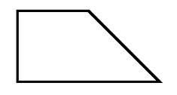
Area Foldable
Area of a Rectangle A = lw | A = bh Area of a Parallelogram
Area of a Triangle A = ½ bh | A = ½ (b1 + b2)h Area of a Trapezoid

Slide 11
Area Foldable
Area of a Rectangle A = lw A = (9cm)(3cm) A= 27 cm² | A = lw 9 cm 3 cm | A = bh 6 in 4 in | Area of a Parallelogram A = bh A = (4in)(6in) A= 24 in²
Area of a Triangle A= ½ bh A= ½(6m)(7m) A = ½ (42m²) A = 21 m² | A = ½ bh 7m 6m | A = ½ (b1 + b2)h 2cm 3cm 6cm | Area of a Trapezoid A = ½ (b1 + b2)h A = ½(2cm + 4cm)3cm A = ½ (6cm)3cm A = ½ (18cm²) A = 9cm²

Slide 12
Lesson 3: Area of Trapezoids

Slide 13
Lesson 3: Area of Trapezoids
Example 1: Find the area of the Trapezoid.
The bases are 5 inches and 12 inches.
The height is 7 inches.
A = 1/2h (b1 + b2) Area of a trapezoid
A = ½(7)(5 + 12) Add 5 and 12
A = ½(7)(17) Multiply
A = 1/2 (119) Divide by 2
A = 59.5 square inches
5in
7 in
12 in

Slide 14
Lesson 3: Area of Trapezoids
Example 2: Find the area of the Trapezoid.
7m
A = 1/2h (b1 + b2)
A = ½(9.8)(7 + 12)
A = ½(9.8)(19)
A = 1/2 (186.2)
A = 93.1 square meters
9.8m
12 m

Slide 15
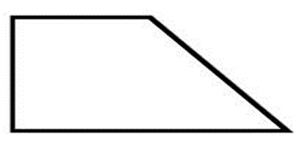
Lesson 3: Area of Trapezoids
Got It? Do these problems to find out.
a. b. 2.5m
11cm
8cm
4 m
14cm
4.8 m

Slide 16
Lesson 3: Area of Trapezoids
Example 3: The trapezoid has an area of 108 square feet. Find the height.
A = 1/2h (b1 + b2)
108 = ½(h)(12 + 15)
108 = ½(h)(27)
27 27
4 = 1/2 (h)
(2)4 = ½(2)(h)
h = 8 ft
12ft
h
15ft

Slide 17
Lesson 3: Area of Trapezoids
Got It? Do these problems to find out.
A = 24 cm² b1 = 4cm b2 = 12cm h = ? A = ½(h)(b1 + b2) | d. A = 21 yd² b1 = 2yd b2 = 5yd h = ? A = ½(h)(b1 + b2)

Slide 18
Lesson 3: Area of Trapezoids
Example 4:

Slide 19
Lesson 3: Area of Trapezoids
Guided Practice: Find the area of each trapezoid. Round to the nearest tenth if necessary.
1. 2.
6m
7ft
8m
8ft
15.6ft
11m

Slide 20
Lesson 3: Area of Trapezoids
Guided Practice: Find the area of each Trapezoid
A trapezoid has an area of 15 square feet. If the bases are 4 feet and 6 feet, what is the height of the trapezoid?

Slide 21
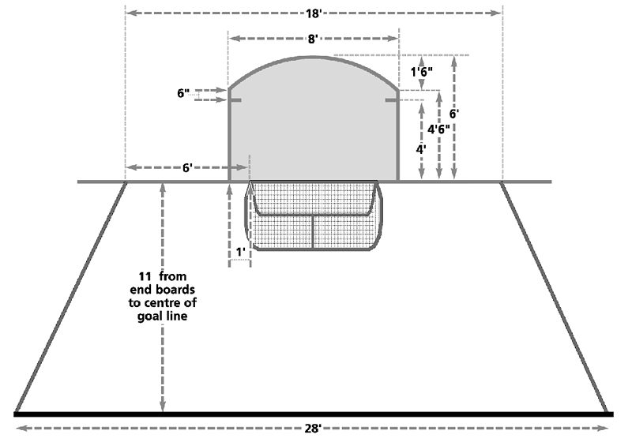
Lesson 3: Area of Trapezoids
Guided Practice: Find the area of each Trapezoid
4. In the National Hockey League, goaltenders can play the puck behind the goal line only in a trapezoid shaped area, as shown at the right. Find the area of the trapezoid.
18 ft
11 ft
28ft

Slide 22
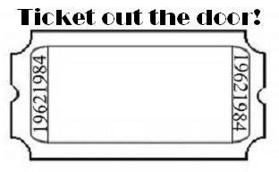
Lesson 3: Area of Trapezoid
How do you find the area of a trapezoid?

