Slide 1
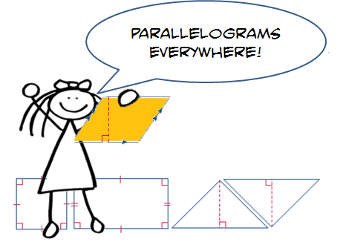
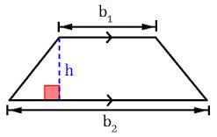
Unit 5: Area and Volume Part I: Area
Area of Parallelograms
Area of Triangles
Area of Trapezoids
Changes in Dimensions
Area of Composite Figures

Slide 2
Georgia Standards
MCC6.G.1.Find the area of right triangles, other triangles, special quadrilaterals, and polygons by composing into rectangles or decomposing into triangles and other shapes; apply these
techniques in the context of solving real world and mathematical problems.
MCC6.G.2.Find the volume of a right rectangular prism with fractional edge lengths by packing it with unit cubes of the appropriate unit fraction edge lengths, and show that the volume
is the same as would be found by multiplying the edge lengths of the prism. Apply the formulas V = l w h and V = b h to find volumes of right rectangular prisms with fractional edge lengths in the context of solving real -world and mathematical problems.
MCC6.G.4.Represent three - dimensional figures using nets made up of rectangles and triangles, and use the nets to find the surface area of these figures.

Slide 3
Mathematical Practices
Make sense of problems and persevere in solving them.
Reason abstractly and quantitatively.
Construct viable arguments and critique the reasoning of others.
Model with mathematics
Use appropriate tools strategically.
Attend to precision.
Look for and make use of structure.
Look for and express regularity in repeated reasoning

Slide 4
Essential Questions
How does measurement help you solve problems in everyday life?
How do you find the areas of composite figures?

Slide 5
Vocabulary
Area: is the number of square units needed to cover the surface of the figure.
Base: a side or bottom.
Composite Figure: is a figure made of two or more two-dimensional figures.
Congruent: figures that are the same shape and size.
Formula: an equation that shows the relationship among certain quantities.
Height: is the perpendicular distance from the base to the opposite side.
Parallelogram: is a quadrilateral with opposite sides parallel and opposite sides the same length.
Polygon: is a closed figure formed by 3 or more straight lines.
Rhombus: is a parallelogram with four equal sides.

Slide 6
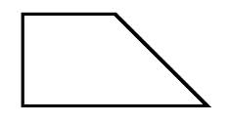
Area Foldable
Area of a Rectangle A = lw | A = bh Area of a Parallelogram
Area of a Triangle A = ½ bh | A = ½ (b1 + b2)h Area of a Trapezoid

Slide 7
Area Foldable
Area of a Rectangle A = lw A = (9cm)(3cm) A= 27 cm² | A = lw 9 cm 3 cm | A = bh 6 in 4 in | Area of a Parallelogram A = bh A = (4in)(6in) A= 24 in²
Area of a Triangle A= ½ bh A= ½(6m)(7m) A = ½ (42m²) A = 21 m² | A = ½ bh 7m 6m | A = ½ (b1 + b2)h 2cm 3cm 6cm | Area of a Trapezoid A = ½ (b1 + b2)h A = ½(2cm + 4cm)3cm A = ½ (6cm)3cm A = ½ (18cm²) A = 9cm²

Slide 8
Lesson 5: Area of Composite Figures
A composite figure is a figure made of two or more two-dimensional figures. The composite figure shown is made of two rectangles.
Draw a composite figure made of a rectangle
And a right triangle on the grid below.

Slide 9
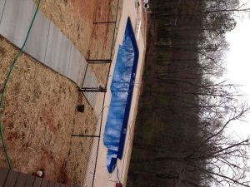
Lesson 5: Area of Composite Figures
Real-World Link
What two-dimensional figures are used to make the shape of the pool?
How could you determine the area of the pool floor?

Slide 10
Lesson 5: Area of Composite Figures
Example 1: Find the area of the figure.
Look at the figure. Into what two shapes could the figure be divided?
Shape 1:_________________
Shape 2:_________________
What is the formula to find the Area for Shape 1?___________
What are the dimensions for Shape 1?
What is the Area of Shape 1?
4 in
6 in
6 in
10 in
*Draw and Label Shape 1

Slide 11
Lesson 5: Area of Composite Figures
Example 1: Find the area of the figure.
What is the formula to find the Area for Shape 2?___________
What are the dimensions for Shape 2?
What is the Area of Shape 2?
Add the Area of Shape 1 and Shape 2 to find the Total Area.
4 in
6 in
6 in
10 in
*Draw and Label Shape 2

Slide 12
Lesson 5: Area of Composite Figures
Example A: Find the area of the figure.
Look at the figure. Into what two shapes could the figure be divided?
Shape 1:_________________
Shape 2:_________________
What is the formula to find the Area for Shape 1?___________
What are the dimensions for Shape 1?
What is the Area of Shape 1?
8 ft
10 ft
4 ft
12 ft
*Draw and Label Shape 1

Slide 13
Lesson 5: Area of Composite Figures
Example A: Find the area of the figure.
What is the formula to find the Area for Shape 2?___________
What are the dimensions for Shape 2?
What is the Area of Shape 2?
Add the Area of Shape 1 and Shape 2 to find the Total Area.
8 ft
10 ft
4 ft
12 ft
*Draw and Label Shape 2

Slide 14
Lesson 5: Area of Composite Figures
Example B: Find the area of the figure.
Look at the figure. Into what two shapes could the figure be divided?
Shape 1:_________________
Shape 2:_________________
What is the formula to find the Area for Shape 1?___________
What are the dimensions for Shape 1?
What is the Area of Shape 1?
5 m
10 m
7 m
7 m
*Draw and Label Shape 1

Slide 15
Lesson 5: Area of Composite Figures
Example B: Find the area of the figure.
What is the formula to find the Area for Shape 2?___________
What are the dimensions for Shape 2?
What is the Area of Shape 2?
Add the Area of Shape 1 and Shape 2 to find the Total Area.
5 m
10 m
7 m
7 m
*Draw and Label Shape 2

Slide 16
Lesson 5: Area of Composite Figures
Example 2: Find the area of the pool’s floor.
Look at the figure. Into what two shapes could the figure be divided?
Shape 1:_________________
Shape 2:_________________
What is the formula to find the Area for Shape 1?___________
What are the dimensions for Shape 1?
What is the Area of Shape 1?
*Draw and Label Shape 1

Slide 17
Lesson 5: Area of Composite Figures
Example 2: Find the area of the pool’s floor.
What is the formula to find the Area for Shape 2?___________
What are the dimensions for Shape 2?
What is the Area of Shape 2?
Add the Area of Shape 1 and Shape 2 to find the Total Area.
*Draw and Label Shape 2

Slide 18
Lesson 5: Area of Composite Figures
Example C: Find the area of the figure.
Look at the figure. Into what two shapes could the figure be divided?
Shape 1:_________________
Shape 2:_________________
What is the formula to find the Area for Shape 1?___________
What are the dimensions for Shape 1?
What is the Area of Shape 1?
20 ft
20 ft
14 ft
36 ft
*Draw and Label Shape 1

Slide 19
Lesson 5: Area of Composite Figures
Example C: Find the area of the figure.
What is the formula to find the Area for Shape 2?___________
What are the dimensions for Shape 2?
What is the Area of Shape 2?
Add the Area of Shape 1 and Shape 2 to find the Total Area.
20 ft
20 ft
14 ft
36 ft
*Draw and Label Shape 2

Slide 20
Lesson 5: Area of Composite Figures
Example 3: Find the area of the figure.
Look at the figure. Into what two shapes could the figure be divided?
Shape 1:_________________
Shape 2:_________________
What is the formula to find the Area for Shape 1?___________
What are the dimensions for Shape 1?
What is the Area of Shape 1?
12 cm
6cm
12 cm
8cm
12 cm
15 cm
*Draw and Label Shape 1

Slide 21
Lesson 5: Area of Composite Figures
Example 3: Find the area of the figure.
What is the formula to find the Area for Shape 2?___________
What are the dimensions for Shape 2?
What is the Area of Shape 2?
Add the Area of Shape 1 and Shape 2 to find the Total Area.
12 cm
6cm
12 cm
8cm
12 cm
15 cm
*Draw and Label Shape 2

Slide 22
Lesson 5: Area of Composite Figures
Example D: Find the area of the figure.
Look at the figure. Into what two shapes could the figure be divided?
Shape 1:_________________
Shape 2:_________________
What is the formula to find the Area for Shape 1?___________
What are the dimensions for Shape 1?
What is the Area of Shape 1?
6 ft
2 ft
7 ft
6 ft
1 ft
8 ft
*Draw and Label Shape 1

Slide 23
Lesson 5: Area of Composite Figures
Example D: Find the area of the figure.
What is the formula to find the Area for Shape 2?___________
What are the dimensions for Shape 2?
What is the Area of Shape 2?
Add the Area of Shape 1 and Shape 2 to find the Total Area.
6 ft
2 ft
7 ft
6 ft
1 ft
8 ft
*Draw and Label Shape 2

Slide 24
Lesson 5: Area of Composite Figures
Example 4: Charlie and his brother Matthew are neighbors in an apartment complex where they share a patio. What is the area of both apartments and the patio?
Look at the figure. Into what two shapes could the figure be divided?
Shape 1:_________________
Shape 2:_________________
What is the formula to find the Area for Shape 1?___________
What are the dimensions for Shape 1?
What is the Area of Shape 1?
*Draw and Label Shape 1

Slide 25
Lesson 5: Area of Composite Figures
Example D: Charlie and his brother Matthew are neighbors in an apartment complex where they share a patio. What is the area of both apartments and the patio?
What is the formula to find the Area for Shape 2?___________
What are the dimensions for Shape 2?
What is the Area of Shape 2?
Add the Area of Shape 1 and Shape 2 to find the Total Area.
*Draw and Label Shape 2

Slide 26
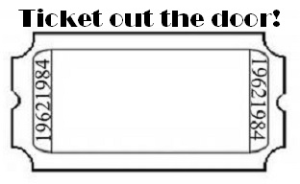
Lesson 5: Area of Composite Figures
Describe how to find the area of a composite figure.

