Slide 1
Period | Code
1 | 935376
4 | 350200
5 | 569625
6 | 122749
Statistical Questions Checkpoint

Slide 2
Describing Shape of Data Distributions

Slide 3
Words to Describe Data Distribution
Cluster
Gap
Peak
Symmetrical (Symmetrical, Skewed Right, or Skewed Left)

Slide 4
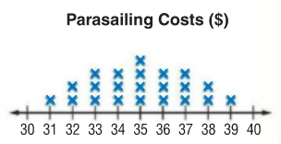
Describe the shape of the distribution. Include peak, cluster, gaps and symmetry.

Slide 5
Sample Answer
This data is very symmetrical because the left side of the data looks like the right side of the data. There are no gaps, and the data peaks at $35.

Slide 6
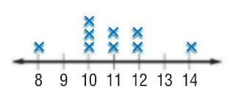
Describe the shape of the distribution. Include peak, cluster, gaps and symmetry.

Slide 7
Sample Answer

Slide 8
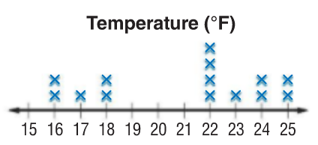
Describe the shape of the distribution. Include peak, cluster, gaps and symmetry.

Slide 9
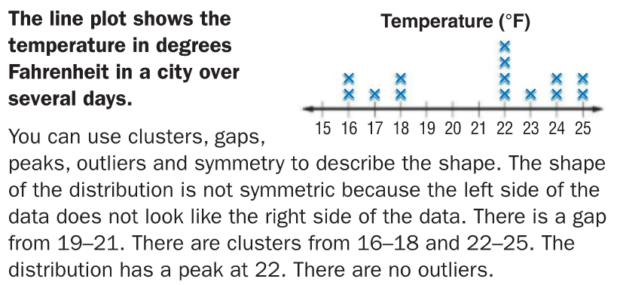
Sample Answer

Slide 10
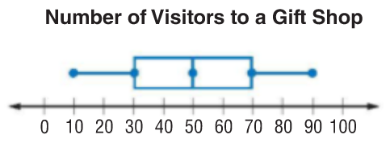
Describe the shape of the distribution. Include peak, cluster, gaps and symmetry.

Slide 11
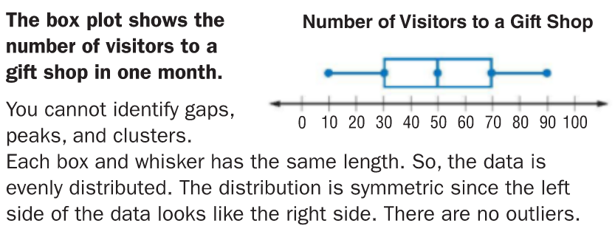
Sample Answer

Slide 12
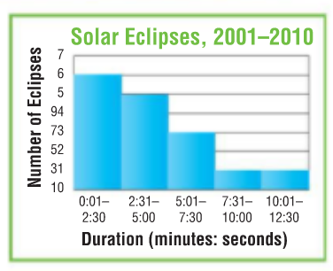
Describe the shape of the distribution. Include peak, cluster, gaps and symmetry.

Slide 13
Sample Answer

Slide 14
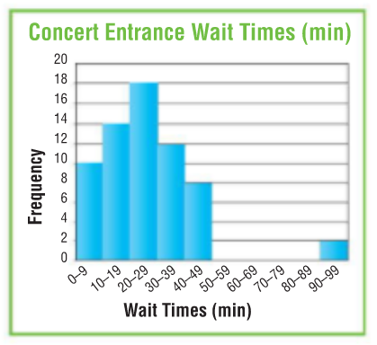
Describe the shape of the distribution. Include peak, cluster, gaps and symmetry.

Slide 15
Sample Answer

Slide 16
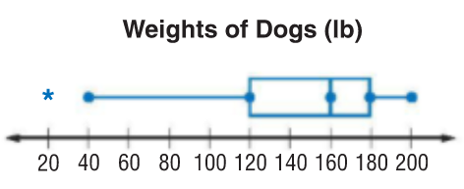
Describe the shape of the distribution. Include peak, cluster, gaps and symmetry.

Slide 17
Sample Answer

Slide 18
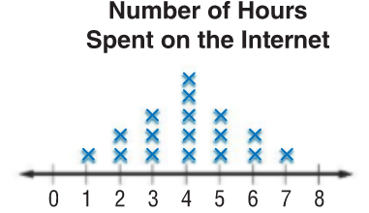
Describe the shape of the distribution. Include peak, cluster, gaps and symmetry.

Slide 19
Sample Answer
This data is very symmetrical because the left side of the data looks like the right side of the data. There are no gaps, and the data peaks at 4 hours.

