Slide 1
Least Common Multiple Here’s the dilemma: Hot dog buns come in packs of 6 and hot dogs come in packs of 8. If we want there to be no leftover buns or dogs, how many bags will we have to buy of each? What is Least Common Multiple? Least common multiple, or LCM, is the ______________ multiple that 2 or more numbers have in common. How do we find it?

Slide 2
METHOD 1: List the multiples of one of the numbers. Then, begin listing the multiples of the other number until you find one that they have in common. Try it! Find the LCM of 6 and 8: Multiples of 6: Multiples of 8: The LCM of 6 and 8 is ______________.

Slide 3
METHOD 2: 1. Find the GCF of the numbers 2. Multiply the two numbers together 3. Divide the product by the GCF. Try it! Use this method to find the LCM of 4 and 8:
Step 1: Find the GCF of 4 and 8
Step 2: Multiply 4 x 8

Slide 4
The LCM of 4 and 8 is _____________
Step 3: Divide your product from Step 2 by your GCF in Step 1.

Slide 5
20 and 8- Using Ladder

Slide 6
12 and 42-Using Method 1

Slide 7
30 and 65- Using Method 2

Slide 8
12 and 21- Using Ladder

Slide 9
45 and 60- Any Method

Slide 10
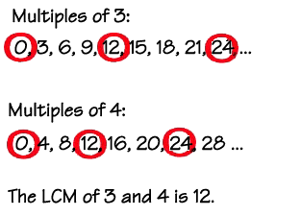
Least Common Multiples
Least Common Multiple | Factors and multiples | Khan Academy
A common multiple is a number that is a multiple of two or more numbers. The common multiples of 3 and 4 are
0, 12, 24, ....
The least common multiple (LCM) of two numbers is the smallest number (not zero) that is a multiple of both.

Slide 11
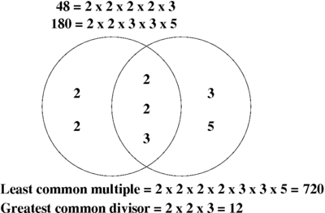
Least Common Multiples
Enspire LCM
matchgeneric Finding LCM
matchgeneric Finding LCM Matching
When will the least common multiple of two numbers be one of the numbers?
Suppose the only factor two numbers have in common is 1. How can you find their least common multiple?

Slide 12
Practice Least Common Multiples
Find the LCM of each. *Hint Use Prime Factorization
1) 10, 3 2) 14, 6

Slide 13
3) 15, 6 4) 15, 20

Slide 14
6) 4, 30 7) 24, 32 8) 20, 30

