Slide 1
Multiplication Review
Multiplication is a simpler way to do repeated addition. For example: 4 x 6 is easier than 4 + 4 + 4 + 4 + 4 + 4. You are also less likely to make a careless error using multiplication than if you use repeated addition.
An array is a way of ordering objects in rows and columns to make a rectangular shape. In an array, all the rows are equal to each other and all the columns are equal to each other and that makes a rectangular shape.
The zero property of multiplication is that any factor multiplied by 0 equals 0. For example: 5 x 0 = 0
The identity property of multiplication is that any factor multiplied by 1 equals the original factor. For example: 3 x 1 = 3
The commutative property of multiplication is that two factors can be multiplied in either order and give the same answer. For example: 7 x 2 = 2 x 7

Slide 2
Multiplication Review
The associative property of multiplication is that three or more factors can be multiplied in different groups and still give the same answer. For example: (4 x 5) x 6 = 4 x (5 x 6)
A number is a factor of another number if it divides into it evenly without a remainder. To find factors of a number you can make a factor rainbow. See the example below: The factors of 24 are 1, 2, 3, 4, 6, 8, 12, and 24.
Prime numbers are numbers that can only be divided evenly by 1 and themselves. For example: 7 is a prime number because it only has 2 factors. These factors and 1 and 7.
Composite numbers are numbers that have more than 2 factors. For example: 4 is a composite number because its factors are 1, 2, and 4.
Since 0 has no factors it is not prime or composite.
Since 1 has only 1 factor it is not prime or composite.
A multiple can be made by multiplying a number. For examples: some multiples of 6 are 6, 12, 18, 24, 30, 36 etc because 1 x 6 = 6, 2 x 6 = 12, 3 x 6 = 18, 4 x 6 = 24, 5 x 6 = 30, 6 x 6 = 36, etc.

Slide 3
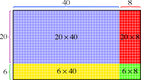
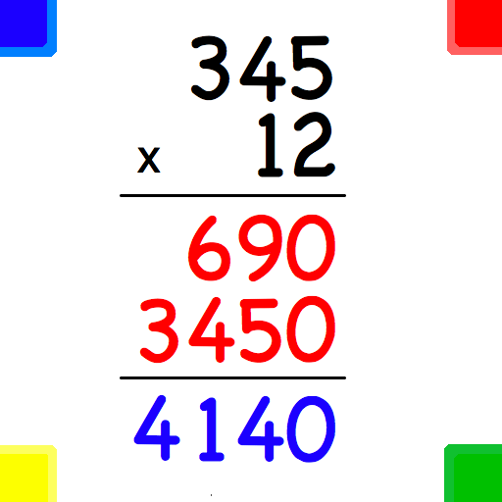
Multiplication Review
Multiplication Game
Math Basketball - Properties of Multiplication
www.multiplication.com

Slide 4
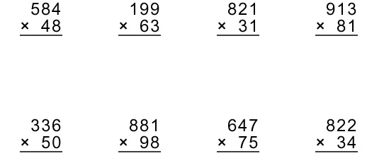
Multiplication Review Skills:

Slide 5
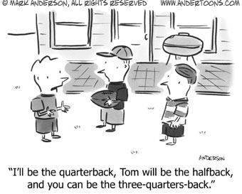
Fraction Frenzy

Slide 6
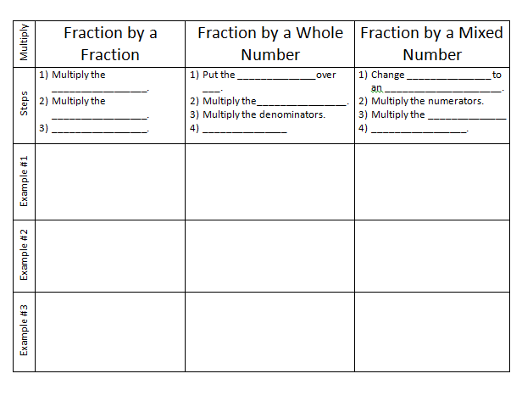

Slide 13
Multiplying Fractions and Mixed Numbers
Find the product and simplify (Write in Simplest Form)
1/3 x 18 =
3/8 x 24 =
12 x ¾ =
1/3 x 1/5 =
3/7 x 5/8 =
11/12 x 4/9 =
2 2/3 x 1 4/5 =
8 ½ x 1 7/9 =
5 ¾ x 10 2/3 =

Slide 15
Practice: (Word Problems)Multiplying Fractions and Mixed Numbers
Find the product and simplify (Write in Simplest Form)
COMPUTERS 1/5 of today’s college students began using computers between the ages of 5 and 8. If a college has 3,500 students, how many of the students began using computers between the ages of 5 and 8?

Slide 16
Practice: (Word Problems)Multiplying Fractions and Mixed Numbers
Find the product and simplify (Write in Simplest Form)
2) EXERCISE A paper published in a medical journal reported that about 12/15 of girls ages 16 to 17 do not exercise at all. The entire study consisted of about 2,500 girls. About how many did not exercise?

Slide 17
Practice: (Word Problems)Multiplying Fractions and Mixed Numbers
Find the product and simplify (Write in Simplest Form)
3) ANIMALS Catherine walks her dog 3/4
mile every day. How far does she walk each week?
4) MUSIC If you practice a musical instrument each day for 2/3 of an hour, how many hours of practice would you get in each week?

