Slide 1
Unit 4 Cornhole Math
Equations, Functions, and Inequalities ☺

Slide 2
Game Directions:
You will work with the people at your table.
Every student will answer the question using an expo marker on your desk.
Your group will compare answers and come up with an overall group answer
When time is called, you will show the answer on your mini white board
If your team is correct, you will send someone to the cornhole board to toss the bag
You MUST retrieve the cornhole bag or your team will lose a point.
You will get 1 point for landing on the board and 3 points for landing in the hole.
The team with the most points wins!

Slide 3
1. Determine if the equation or inequality is true or false for x=6 3x=18

Slide 4
2. Determine if the equation or inequality is true or false for x=6 x + 12=24

Slide 5
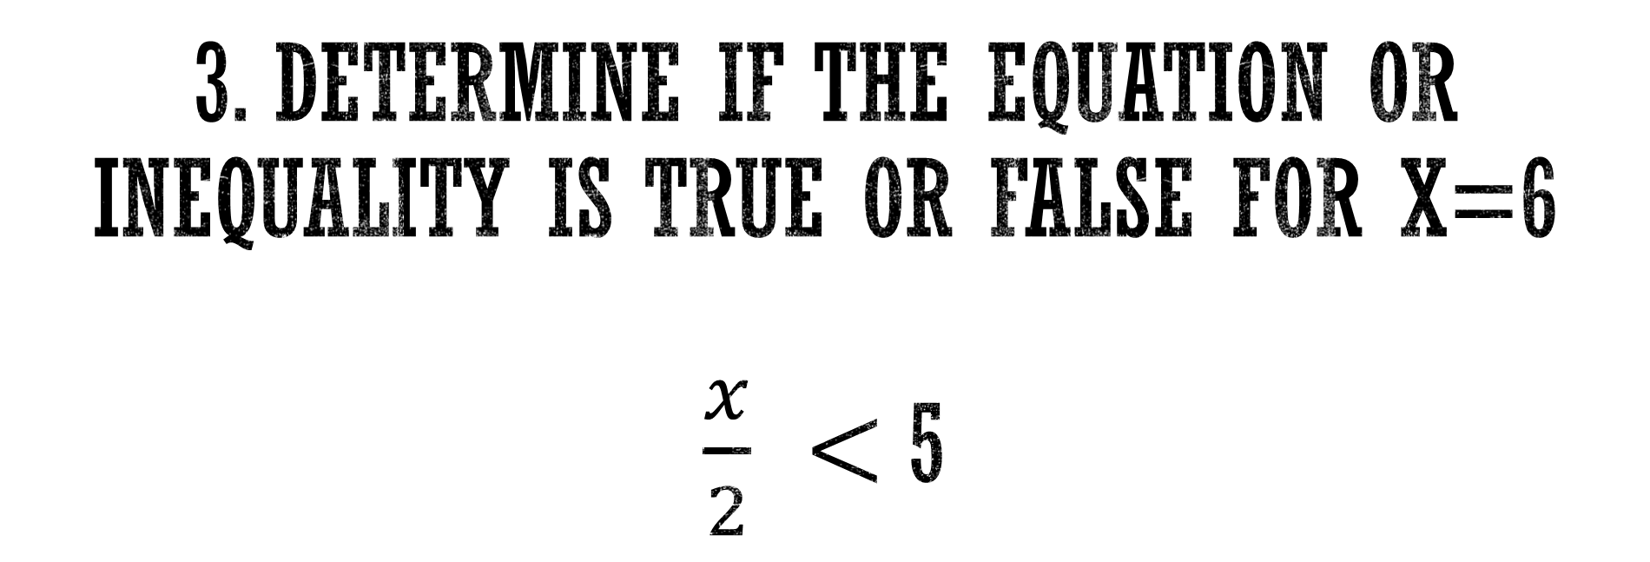
3. Determine if the equation or inequality is true or false for x=6 $\frac{x}{2} <$5

Slide 6
4. Carl solved 12 math problems every hour. Let h represent the total number of hours he has been solving math problems. Write an equation to find the total number of problems he has solved. P=_________

Slide 7
5. Mr. Tyus is creating teams to play volleyball. The number of students that wanted to play and the number of teams are shown in the table below. Write an equation to represent the number of students playing and the number of teams created.
Number of Students | Number of Teams
12 | 2
18 | 3
24 | 4
30 | 5
36 | 6

Slide 8
6. This year, Ms. Rankin is Twice as old as her cousin Paige. If x Represents Ms. Rankin’s age now, what is an equation to represent Paige’s age one year ago?

Slide 9
7. Robert has saved $180 to buy a TV which costs $450. He wants to find how much more he needs to save to buy the TV. Write an equation to help him determine how much he needs to save

Slide 10
8. Solve the equation for M 7m=63

Slide 11
9. 19 + c ≥ 69

Slide 12
10. Taryn bought 6 concert tickets for her friends. The total cost was $606. What is the cost of each ticket?

Slide 13
11. A Train can travel a distance of no more than 8,500 Miles before refueling. Write an inequality to show how many miles a train can travel, t, without having to refuel.

Slide 14
12. A bank requires that customers have more than $200 in their savings account at all times. Write an inequality to show how many dollars can be in a customers account.

Slide 15
13. The Rankin’s Hot tub can hold no more than 3,287 gallons of water. Write an inequality to describe how many gallons of water are in the Rankin’s hot tub.

Slide 16
14. Ms. Rankin waited in line for less than 20 minutes to ride Harry Potter and the Forbidden Journey at Universal studios. Graph an inequality to describe the amount of time Ms. Rankin waited.

Slide 17
15. Write an inequality for the graph

Slide 18
17. x – 7 = 18

Slide 19
18. 9x = 99

Slide 20
19. x – 3 = 0

Slide 21
20. Is x=5 a solution to the inequality? 10 – x < 3

Slide 22
21. Is x=9 a solution to the inequality? 14 + x > 23

Slide 23
22. Is x=42 a solution to the inequality? X > 7 6 p

