Slide 1
Unit 6 Cornhole Math
Introduction to Statistics

Slide 2
Game Directions:
You will work with the people at your table.
Every student will answer the question using an expo marker on your desk.
Your group will compare answers and come up with an overall group answer
When time is called, you will show the answer on your mini white board
If your team is correct, you will send someone to the cornhole board to toss the bag
You MUST retrieve the cornhole bag or your team will lose a point.
You will get 1 point for landing on the board and 3 points for landing in the hole.
The team with the most points wins!

Slide 5
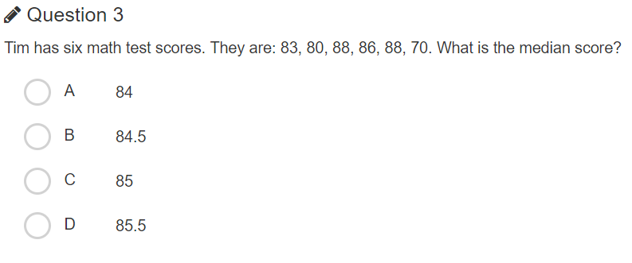

Slide 6
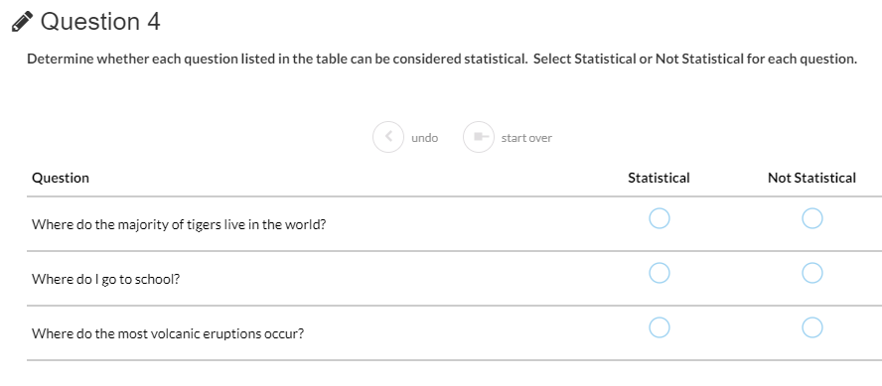

Slide 7
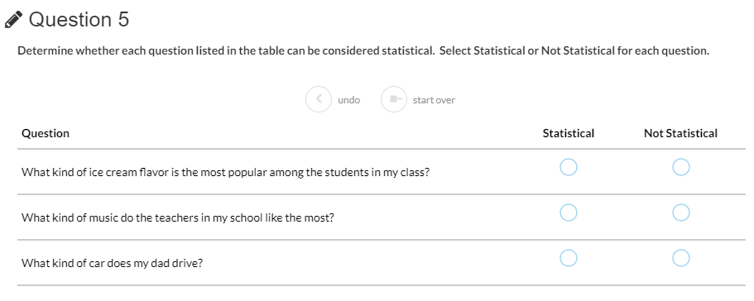

Slide 9
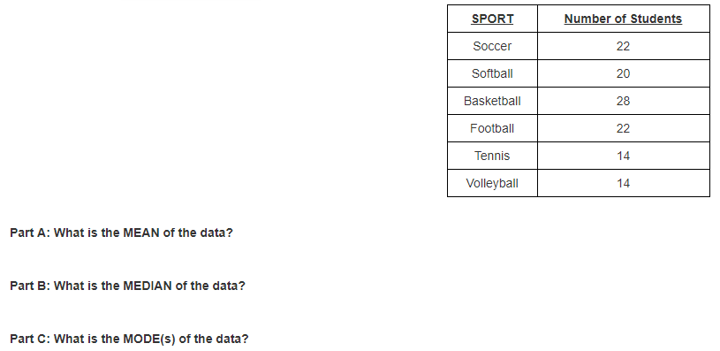

Slide 10
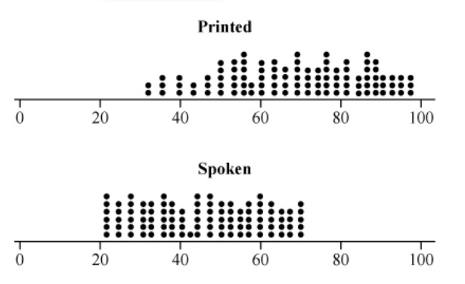
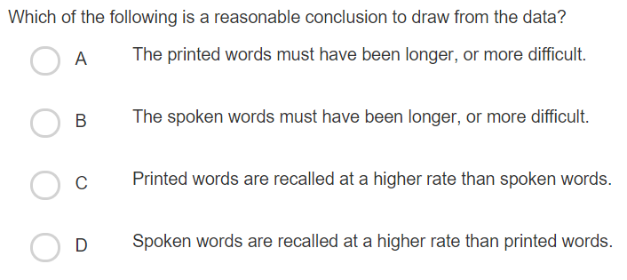

Slide 11
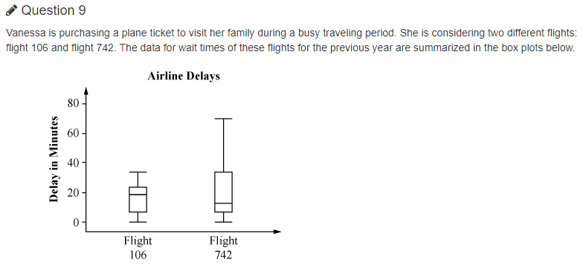
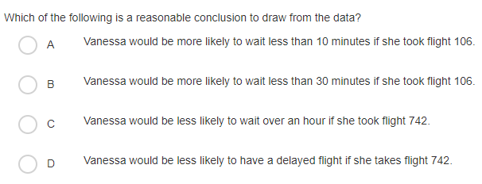

Slide 13
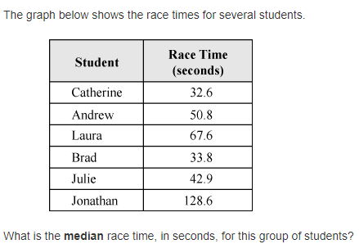

Slide 15
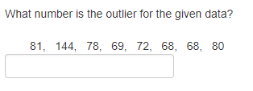

Slide 16
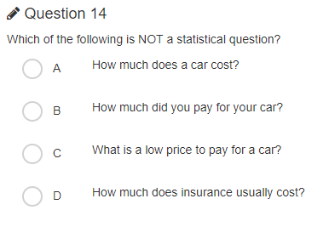

Slide 17
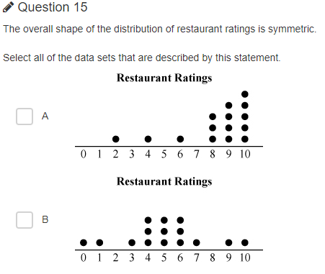
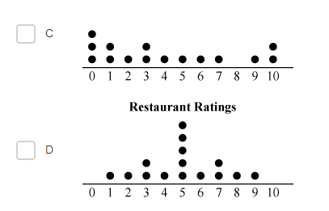

Slide 18
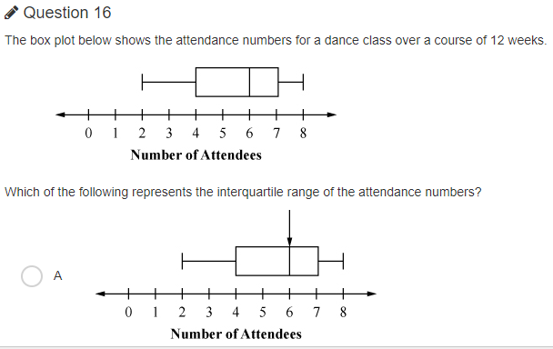
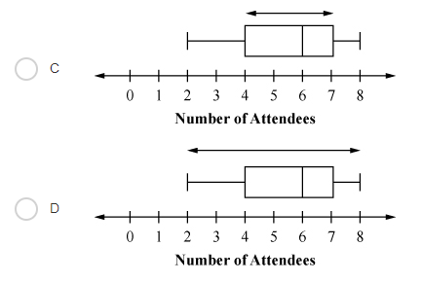
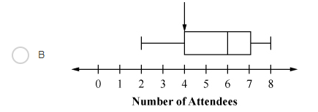

Slide 20
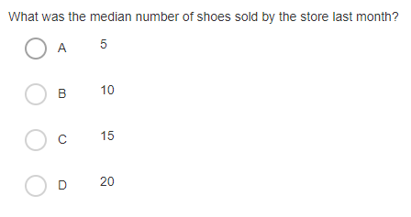

Slide 21
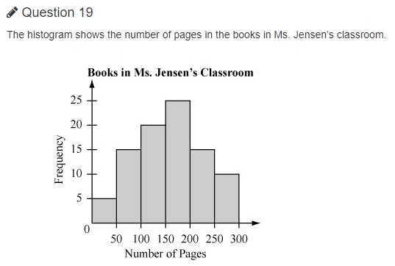
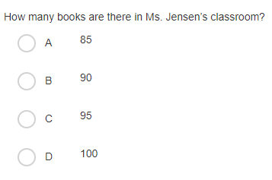

Slide 22
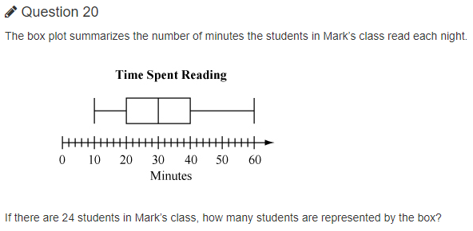
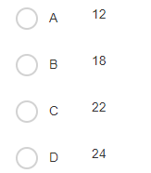

Slide 23
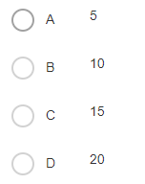

Slide 24
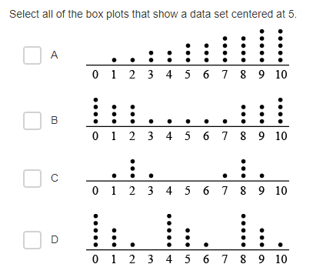

Slide 25
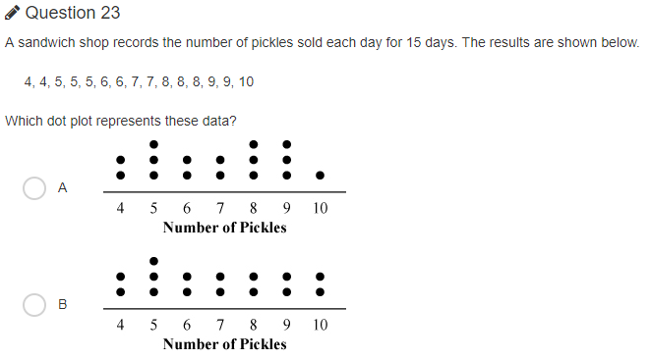
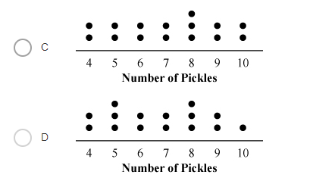

Slide 26
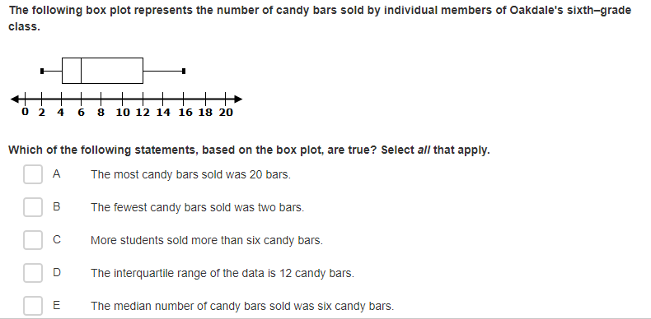

Slide 27
Answer Key: 1. Mean- 25 Median- 17, Mode-14 2. B 3. B 4. N, S, N 5. N, S, n 6. 2 7. 20, 21, 14 & 22 8. C 9. B
10. 146
11. 46.85
12. 52.04
13. 144
14. B
15. B, d
16. c
17. C
18. C
19. B
20. A
21. B
22. B, C
23. D
24. B, E

